Slide 1
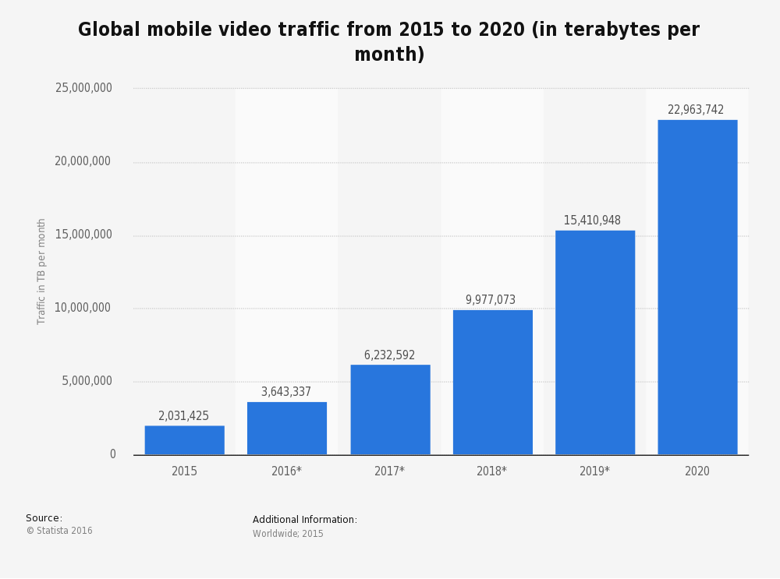
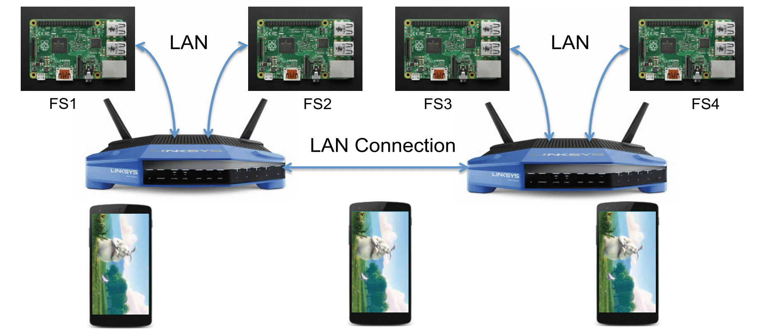
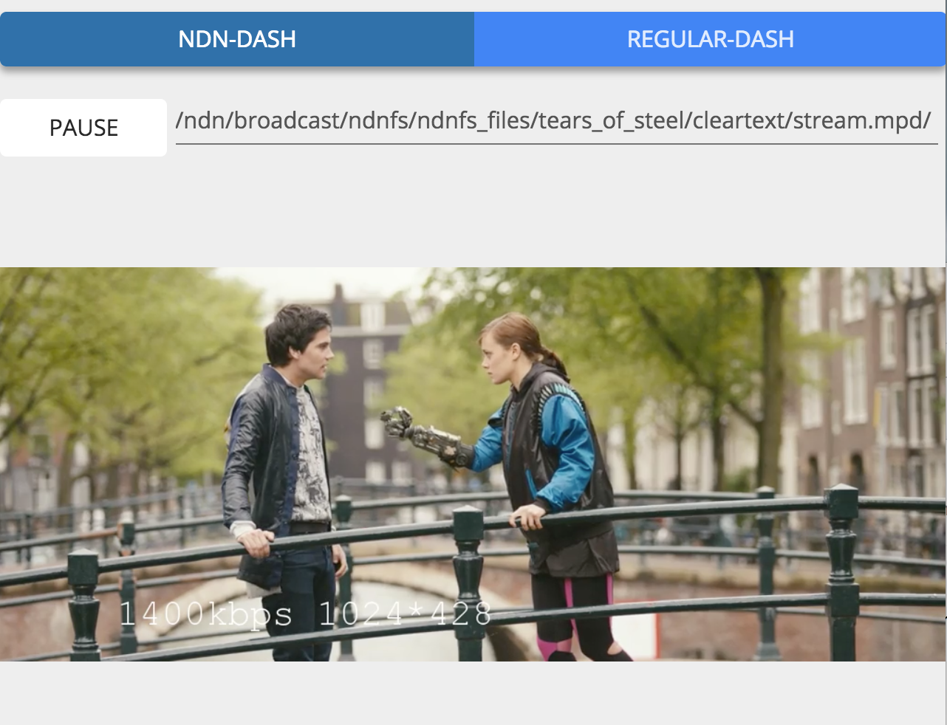
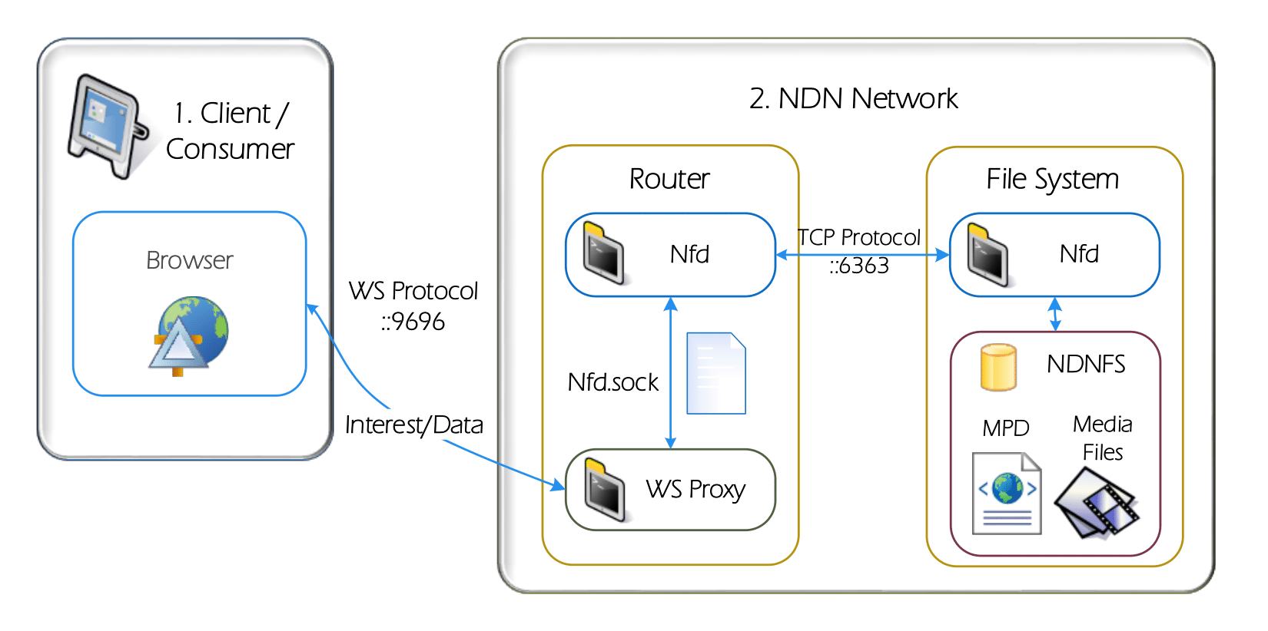
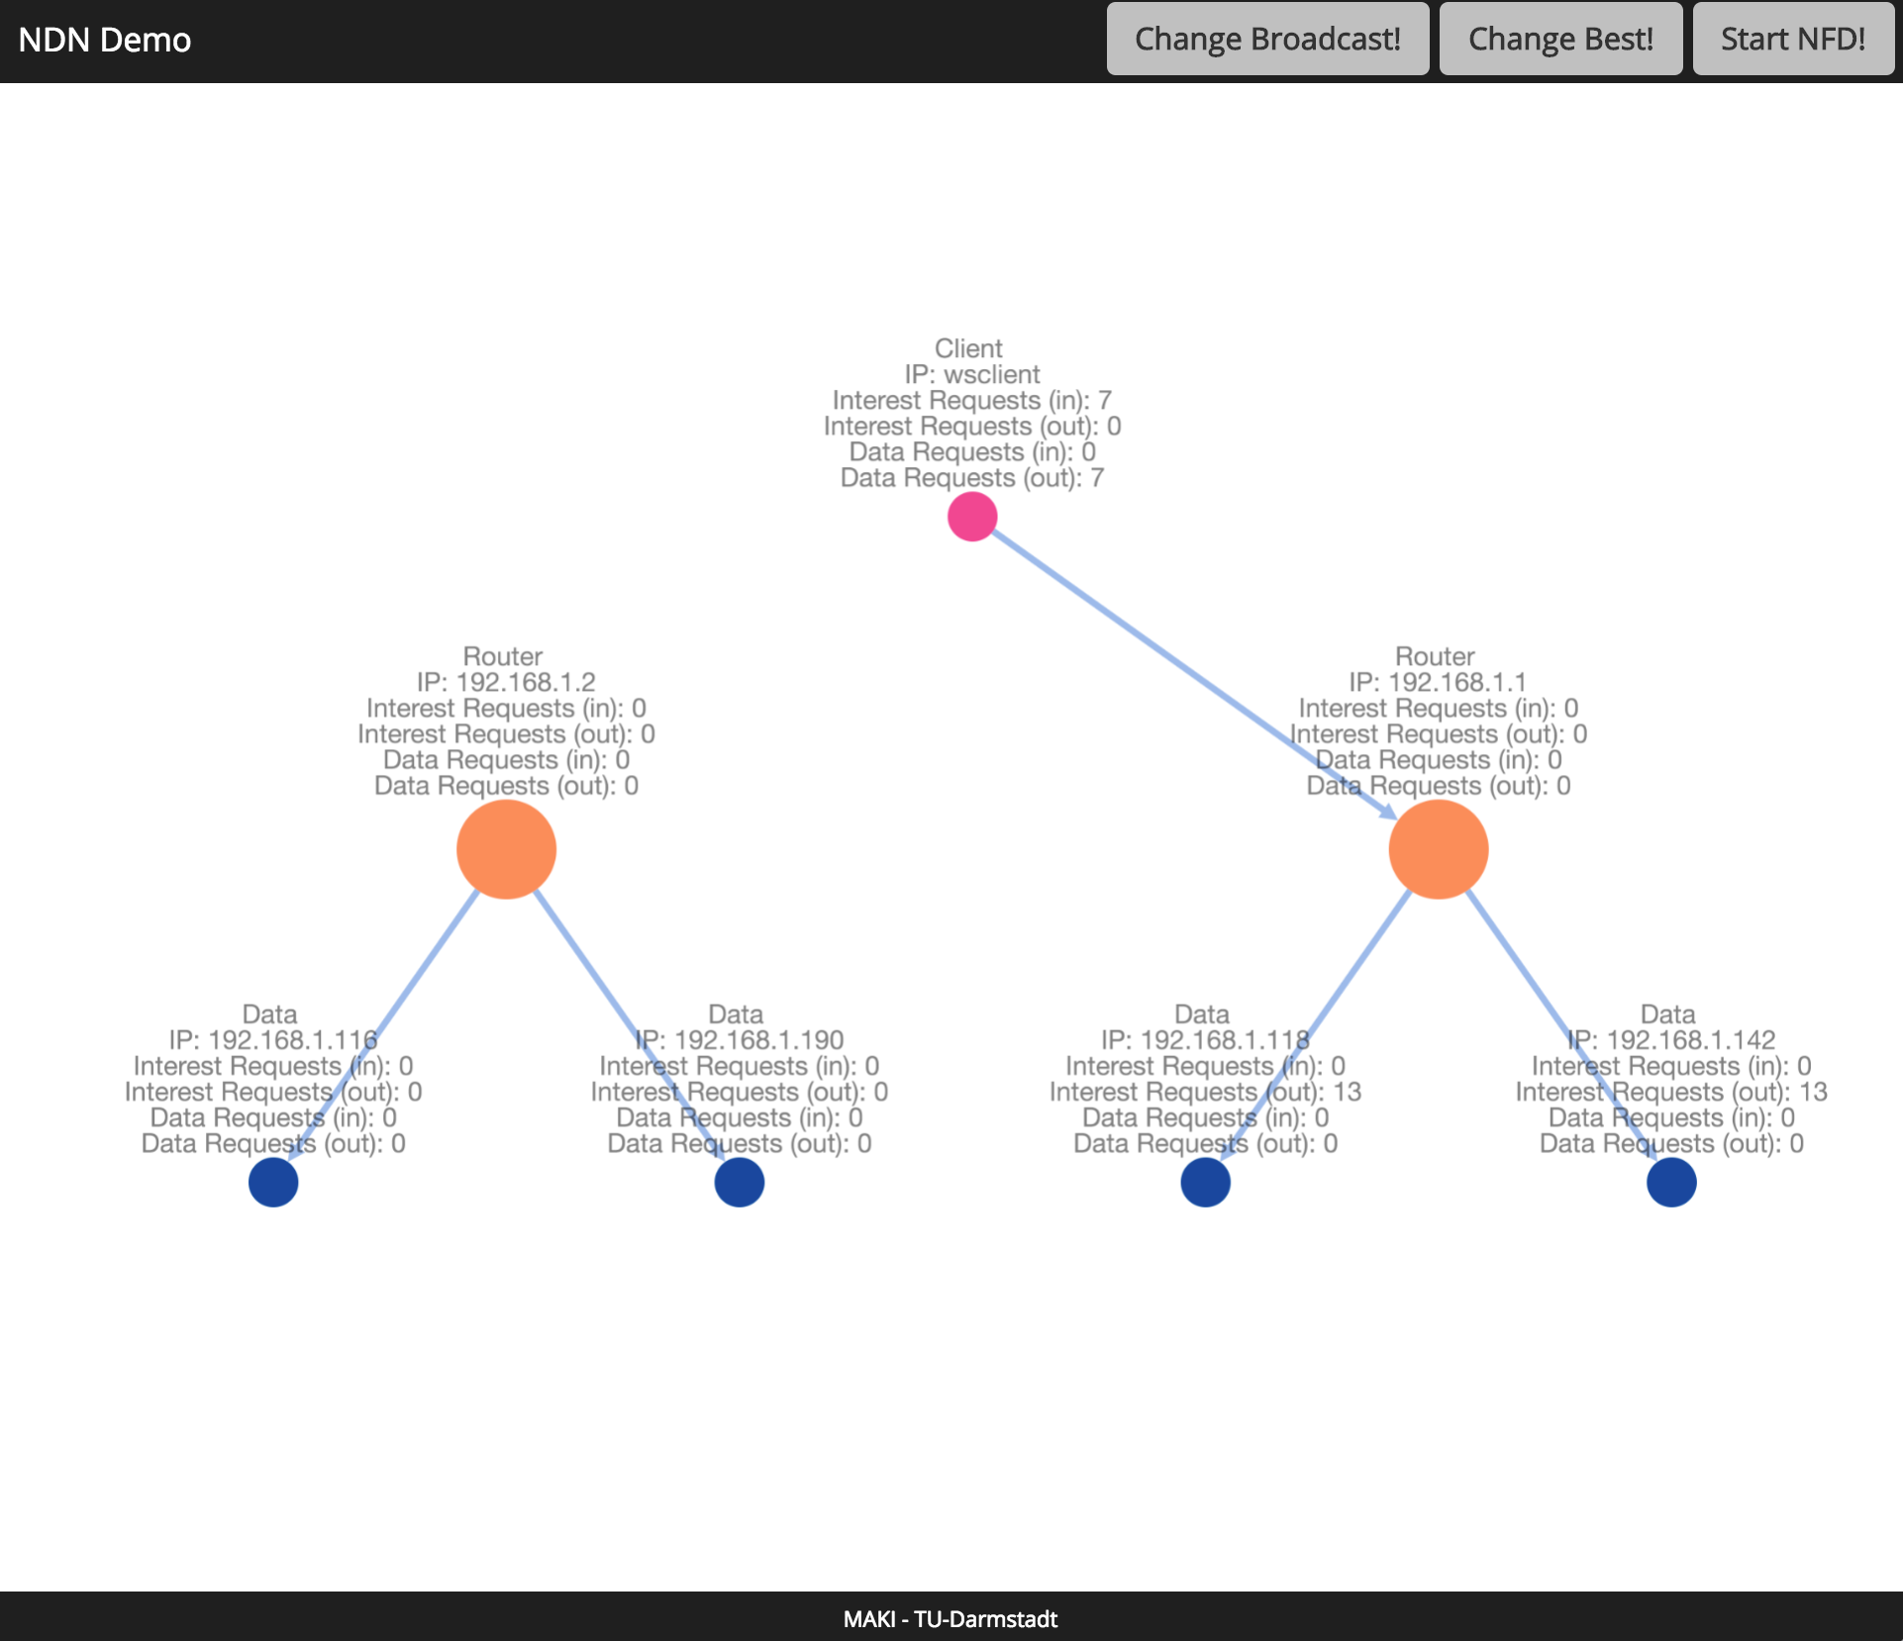
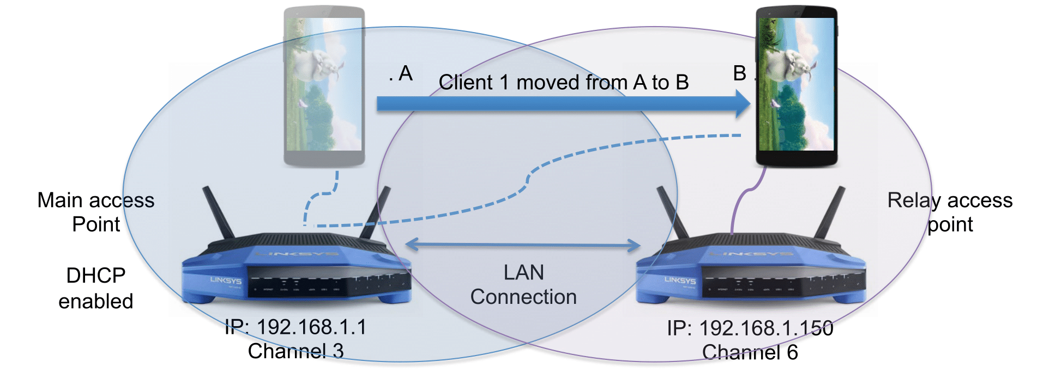


Mobile NDN-Based Dynamic Adaptive Streaming over HTTP (DASH)
Denny Stohr, Fares Beji, Rahul Dwarakanath, Ralf Steinmetz, Wolfgang Effelsberg; TU Darmstadt, Germany
Motivation
Testbed Architecture and Demo Goals
Global (mobile) video traffic rising exponentially
Estimated to reach 82% of all consumer Internet traffic by 2020
Need for flexible and efficient distribution environments of video content
Global mobile video traffic 2015-2020
[Cisco]
Named-Data Networking (NDN) for the Future Internet
Data-centric addressing with requests based on file names rather than host addresses
Interest packets issued by clients to request for data
Network answers with data packet containing requested data
Allows for higher tolerance towards client mobility and host failures through innovative routing and caching strategies
Goal 1: Developing an NDN-based testbed for mobile video
streaming using wireless access points and data storage units
Goal 2: Achieving wide compatability with consumer devices by
employing web-based development concepts
Testbed Hardware Setup
NDN-Based DASH Video Player
NDN-enabled access points
LinkSys WRT-1200-AC routers running custom built OpenWRT
Hosting cross-compiled versions of Named-Data Networking Forwarding Daemon (NFD)
Provide a WebSocket-based interface to NFD for JavaScript client compatability
802.11ac WiFi for seamless switching between clients (client-based handover)
NDN repositories based on Raspberry Pi’s (Model 2B)
Video data repositories, serving requests depending on forwarding strategy and client locations
Executes NFD for packet forwarding, and NDN-FS to serve as media file repository
Stores segmented versions of Media Presentation Description (MPD) files and DASH segments
Client-side DASH video player using JavaScript and HTML5 Media Source Extensions (HTML5-MSE)
Allows streaming of MPEG-DASH-compliant AVC-encoded content
NDN.js used for NDN support
Communication between clients and routers through WebSocket protocol
Video Playback
…
DASH player request pipeline
Client-Based Wireless Handover
User Interface
Visualization of current topology and NDN statistics
Change between forwarding strategies
Display of mobile Client WiFi Handovers
Future Work
Contact Details
I
Evaluation of NDN forwarding and caching strategies
Denny Stohr
Technische Universität Darmstadt
Distributed Multimedia Systems
dstohr@kom.tu-darmstadt.de
II
Transfer of NDN functionality to user smartphones (Android)
III
Use of NDN for User-Generated Videos (UGVs)

